Slide 1

Cansat 2013 PDR Outline
Team # : 1300
Team Frequency

Slide 2
Presentation Outline
1. About The Team
1.1 Team Composition [5]
1.2 Internal Organization [6]
1.3 Acronyms [7]
2. System Overview - Presenter : Syed Tabish Abbas
2.1 Mission Summary [9]
2.2 System Requirement [10-12]
2.3 System Concept of Operations [13-18]
2.4 Physical Layout of Cansat [20-25]
2.5 System Level Cansat Configuration [26]
3. Sensor Systems Design - Presenter : Rahul Gupta
3.1 Sensor Subsystem Overview [28]
3.2 Sensor Subsystem Requirements [29]
3.3 GPS Sensor Selection [30]
3.4 Non-GPS Altitude Sensor Selection [31-32]
3.5 Air Temperature Selection [33]
3.6 Impact Force Sensor [34-35]
3.7 Xbee Selection [36]
4. Descent Control Design - Presenter : Siddharth Singh
4.1 Descent Control Overview [38]
4.2 Descent Control Requirements [39]
4.3 Descent Control Strategy [40]
4.4 Material For Wing Selection [41]
4.5 Descent Rate Estimates [42-43]
4.6 Cansat Detachment Strategy [44]
Presenter: Syed Tabish Abbas

Slide 3
Presentation Outline
5. Mechanical Systems Design - Presenter : Jaswanth Reddy
5.1 Mechanical Systems Overview [46]
5.2 Mechanical Systems Requirement [47]
5.3 Egg Protection Mechanisms [48-49]
5.4 Mechanical Layout of Components [50]
5.5 Estimated Mass Budget [51]
6. Communication and Data Handling Subsystem Design - Presenter : Gauresh Patil
6.1 CDH Overview [53-54]
6.2 CDH Requirements [55-57]
6.3 Processor Selection [58]
6.4 Memory Selection [59]
6.5 Carrier Antenna Selection [60]
6.6 Communication Configuration [61]
6.7 Carrier Telemetry Format [62]
6.8 Autonomous Termination of Transmissions [63]
6.9 Locator Device Selection [64]
7. Electrical Power System Design - Presenter : Shashank Wadhwa
7.1 EPS Overview [66 ]
7.2 EPS Requirements [67]
7.3 Cansat Electrical Block Diagram [68]
7.4 Power Control [69]
7.5 Power Budget [70-71]
7.6 Power Source Selection [72]
7.7 Battery Voltage Measurement [73]
7.8 EPS Testing Overview [74]
Presenter: Syed Tabish Abbas

Slide 4
Presentation Outline
8. Flight Software Design - Presenter : Rakesh N R
8.1 FSW Overview [76-77]
8.2 FSW Requirements [78]
8.3 Software Flow Diagram [79]
8.4 Sensor Update [80]
9. Ground Control System Design - Presenter : Rakesh N R
9.1 GCS Overview [82]
9.2 GCS Requirements [83]
9.3 Antenna Selection [84]
10. Cansat Integration and Test - Presenter : Syed Tabish Abbas
10.1 Integration of Cansat Subsystem [86]
10.2 Tests Performed [87-89]
10.3 Tests to be Performed [90]
11. Mission Operation and Analysis - Presenter : Siddharth Singh
11.1 Overview of Mission Sequence of Events [92]
11.2 Landing Coordinate Prediction [93]
11.3 Cansat Location and Recover [94]
12. Management - Presenter : Siddharth Singh
12.1 Cansat Budget [96]
12.3 Program Schedule [97-98]
12.4 Mechanical Team Schedule [99-100]
14. Conclusions [101]
Presenter: Syed Tabish Abbas

Slide 5
Team Organization
No. | Name | Year of study | Position | Contact details
1 | Syed Tabish Abbas | 3rd yr | Team Leader Electronics Team lead | syed.abbas@students.iiit.ac.in
2 | Rakesh N R | 3rd yr | Alternate Team Leader Mechanical Team Lead | rakesh.r@students.iiit.ac.in
3 | Rahul Gupta | 3rd yr | Member, Electronics Team | rahul.g@students.iiit.ac.in
4 | Siddharth Singh | 3rd yr | Member, Mechanical Structure Team | siddharth.singh@students.iiit.ac.in
5 | Gauresh Patil | 3rd yr | Member, Electronics Team | gauresh.patil@students.iiit.ac.in
6 | Shashank Wadhwa | 3rd yr | Member, Mechanical Structure Team | wadhwa.lekhraj@students.iiit.ac.in
7 | Jaswanth Reddy | 3nd yr | Member, Mechanical Structure Team | jaswanth.gangula@students.iiit.ac.in
8 | Akshat Khandelwal | 2nd yr | Member, Electronics Team | akshat.k@students.iiit.ac.in
9 | Priya Bansal | 2nd yr | Member, Mechanical Structure Team | priya.bansal@students.iiit.ac.in
Presenter: Syed Tabish Abbas

Slide 6
Internal Organization
Team Mentor
Jim Yen
Electronics Design
Team
Lead : Syed Tabish
Members : Siddharth Singh
Rahul Gupta
Akshat Khandelwal
Faculty Advisor
Dr. K Madhava
Krishna
Team Leader
Syed Tabish
Mechanical Structure
Team
Lead : Rakesh N R
Members : Gauresh Patil
Shashank Wadhva
Jashwanth Reddy
Priya Bansal
Alternate Team Leader
Rakesh N R
Presenter: Syed Tabish Abbas

Slide 7
Acronyms
M Mission
S Sensor
MS Mechanical System
DCS Descent Control System
CDH Command and Data Handling
EPS Electrical and Power system
FSW Flight Software
GCS Ground control station
A/D Analog or Digital
adc Analog digital converter
clk Clock
cpu Central processing unit
eeprom Electrically Erasable Programmable Read-Only Memory
Fcc Federal communications commission
g Acceleration due to gravity
ghz Giga hertz
gps Global positioning system
Hz Hertz
ism Industrial, scientific and medical
kbps Kilobytes per second
km Kilometer
mhz Mega hertz
NiMH Nickel metal hydride
rf Radio frequency
spi Serial peripheral interface
sram Static random access memory
USART Universal synchronous asynchronous receiver/transmitter
USD US Dollar
INR Indian Rupees
Presenter: Syed Tabish Abbas

Slide 8
Systems Overview
Presenter : Syed Tabish Abbas

Slide 9
Mission Summary
Mission:
The mission of 2013 Cansat competition is Sensor Delivery System.
Objectives:
To carry the hen’s egg intact for the entire duration from launch to landing.
To control the descent of the Container and maintain its speed to less than 20 m/s.
The Container should hold the Cansat till deployment and after the Container reaches 400m after deployment, it should deploy the Cansat containing the egg.
To control the descent of the Cansat after its deployment from the Container at the descend speed of 20 +/- 1 m/s.
To send the telemetry data to a central ground station.
Optional Objective:
To measure the force of impact of the Cansat with the ground and store the data on-board which can later be downloaded.
Presenter: Syed Tabish Abbas

Slide 10
System Requirements
ID | Requirement | Rationale | Priority | Parent(s) | Children | VM
 |  |  |  |  |  | A | I | T | D
SYS-01 | Total mass of the Entire system will be 700 +/- 10gms excluding the egg | There is always a finite limit of the mass that can be put into space | HIGH |  | MS01 DCS02 |  | X | X
SYS-02 | Container will fit in a cylindrical envelope of 130mm diameter and 250 mm in length | Payload structure dimensions are influenced by launch vehicle characteristics | HIGH |  | MS02,03 DCS 04 |  | X
SYS-03 | There will be no protrusions until Container deployment from rocket payload | Payload structure dimensions are influenced by launch vehicle characteristics | HIGH |  | DCS-01,02,03 |  | X
SYS-04 | Container will descent with rate of less than 20m/s and Cansat at rate of 20 +/- 1m/s | So that does not get drifted away by wind safe landing speed | HIGH |  | DCS- 01,02,03,04 | X |  | X | X
Presenter: Syed Tabish Abbas

Slide 11
System Requirements
ID | Requirement | Rationale | Priority | Parent(s) | Children | VM
 |  |  |  |  |  | A | I | T | D
SYS-05 | GCS will have external power control with confirmation from Cansat power state | To avoid Battery consumption when idle and to not to tamper the Cansat while operating. | LOW |  |  |  | X |  | X
SYS-06 | Total cost of the Cansat will not exceed $1000 | Every well managed systems has constraint, to have uniformity | MEDIUM |  |  |  | X
SYS-07 | During descent Cansat will send its position along with house keeping telemetry | To track the health of the Cansat | HIGH |  | S01 MS05 CDH 01,02 |  |  | X | X
Presenter: Syed Tabish Abbas

Slide 12
System Requirements
ID | Requirement | Rationale | Priority | Parent(s) | Children | VM
 |  |  |  |  |  | A | I | T | D
SYS-08 | Cansat will stop transmitting telemeter upon landing and it will calculate the impact force with the ground as requirement of additional objective. | To measure the impact force on the Cansat so as to estimate the amount of maximum force that the Lander can sustain in order to save the egg. | LOW |  | S01 MS05 CDH05 |  |  | X | X
SYS-09 | Container and Cansat should be recovered safely. | To avoid damage to cansat structure and components so that it functions properly after landing. | HIGH |  |  |  |  |  | X
SYS-10 | Team will provide all saved telemetered data transmitted by the Cansat. | As a part of Post Flight Review so as to analyze the telemetered data. | MEDIUM |  | CDH06,07,08 |  |  |  | X
Presenter: Syed Tabish Abbas

Slide 13

System Concept of Operations
Cansat rests inside the container placed in payload section of the rocket
Team developed Ground Control Station
Presenter: Syed Tabish Abbas

Slide 14

System Concept of Operations
Container rests on its parachute still inside the parachute. Wings are folded and sitting inside the container.
Ground Control Station
Presenter: Syed Tabish Abbas

Slide 15
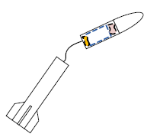
System Concept of Operations
Ejection charge separates payload section from rocket around approx height of 670m.
Ground Control Station
Presenter: Syed Tabish Abbas

Slide 16
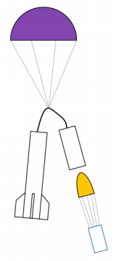
System Concept of Operations
Front section tips over and the container falls out of the payload section. The Container parachute inflates and slows it down.
Ground Control Station receives and visualizes Descent Data Packets
Container starts sending Descent Data Packets as soon as the parachute inflates.
Presenter: Syed Tabish Abbas

Slide 17
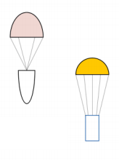
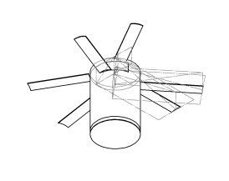
System Concept of Operations
The Container, Nose cone and rocket descend under parachutes. The carrier and lander separate at 400m above ground.
Ground Control Station receives and visualizes Descent Data Packets
Cansat will detach from the Container at 400m above the ground.
Cansat carrier will communicate with the GCS
Presenter: Syed Tabish Abbas

Slide 18
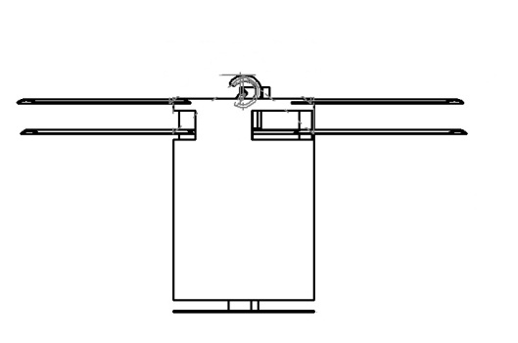
System Concept of Operations
Ground Control Station receives and visualizes Descent Data Packets
Cansat will measure the ground impact force after landing.
Presenter: Syed Tabish Abbas

Slide 19
Physical Layout
Presenter : Rakesh N R

Slide 20
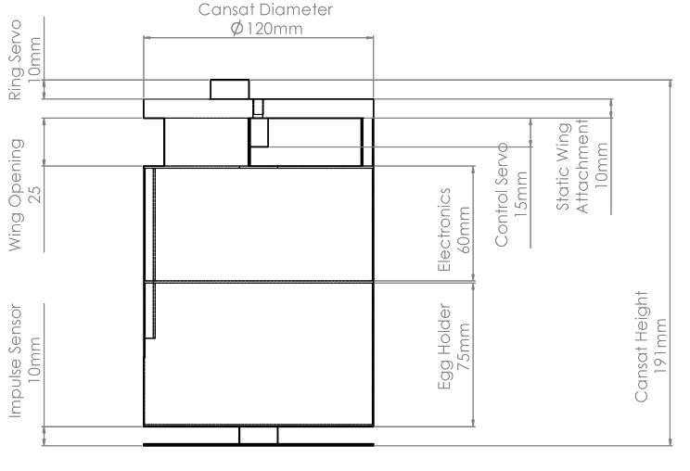
Physical Layout
Cansat – Drawing
Presenter: Rakesh N R

Slide 21
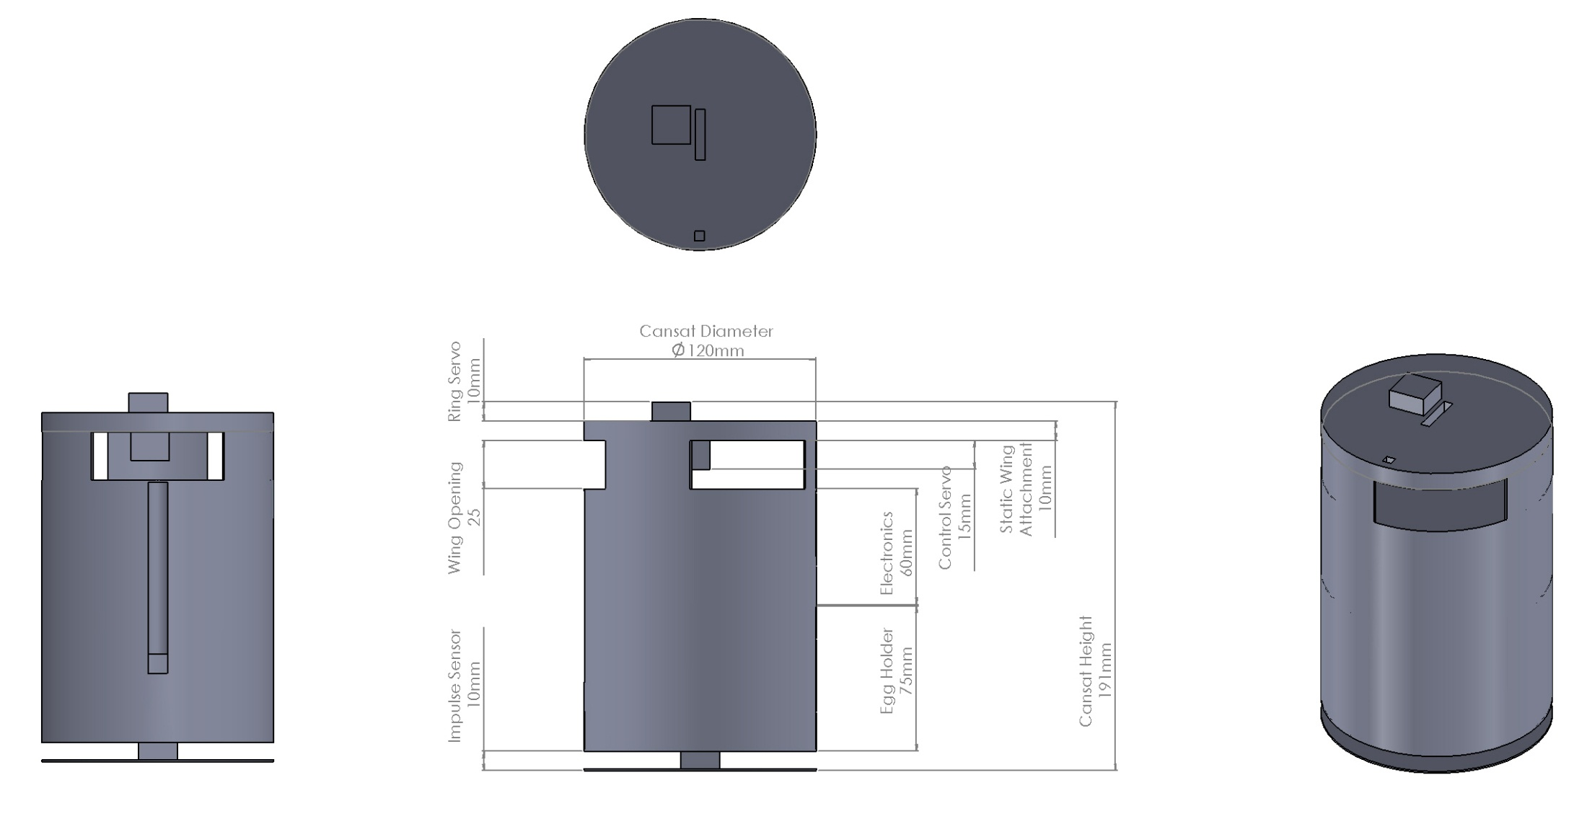
Physical Layout
Servo (Detachment Control)
Ring Slit
Cansat – 3D View
Servo (Wing Control)
Antenna Slit
Wing Slit
Impact Force Sensor
Presenter: Rakesh N R

Slide 22
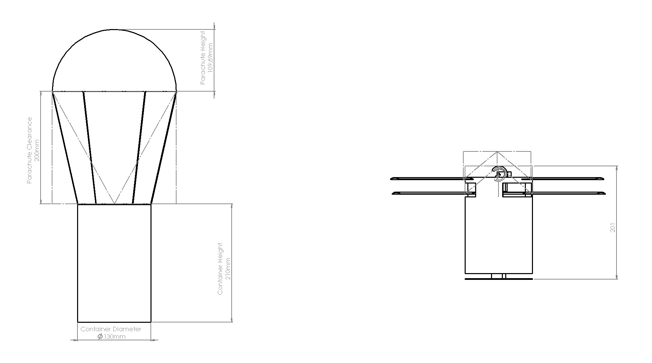
Physical Layout
Design – Front View
Presenter: Rakesh N R

Slide 23
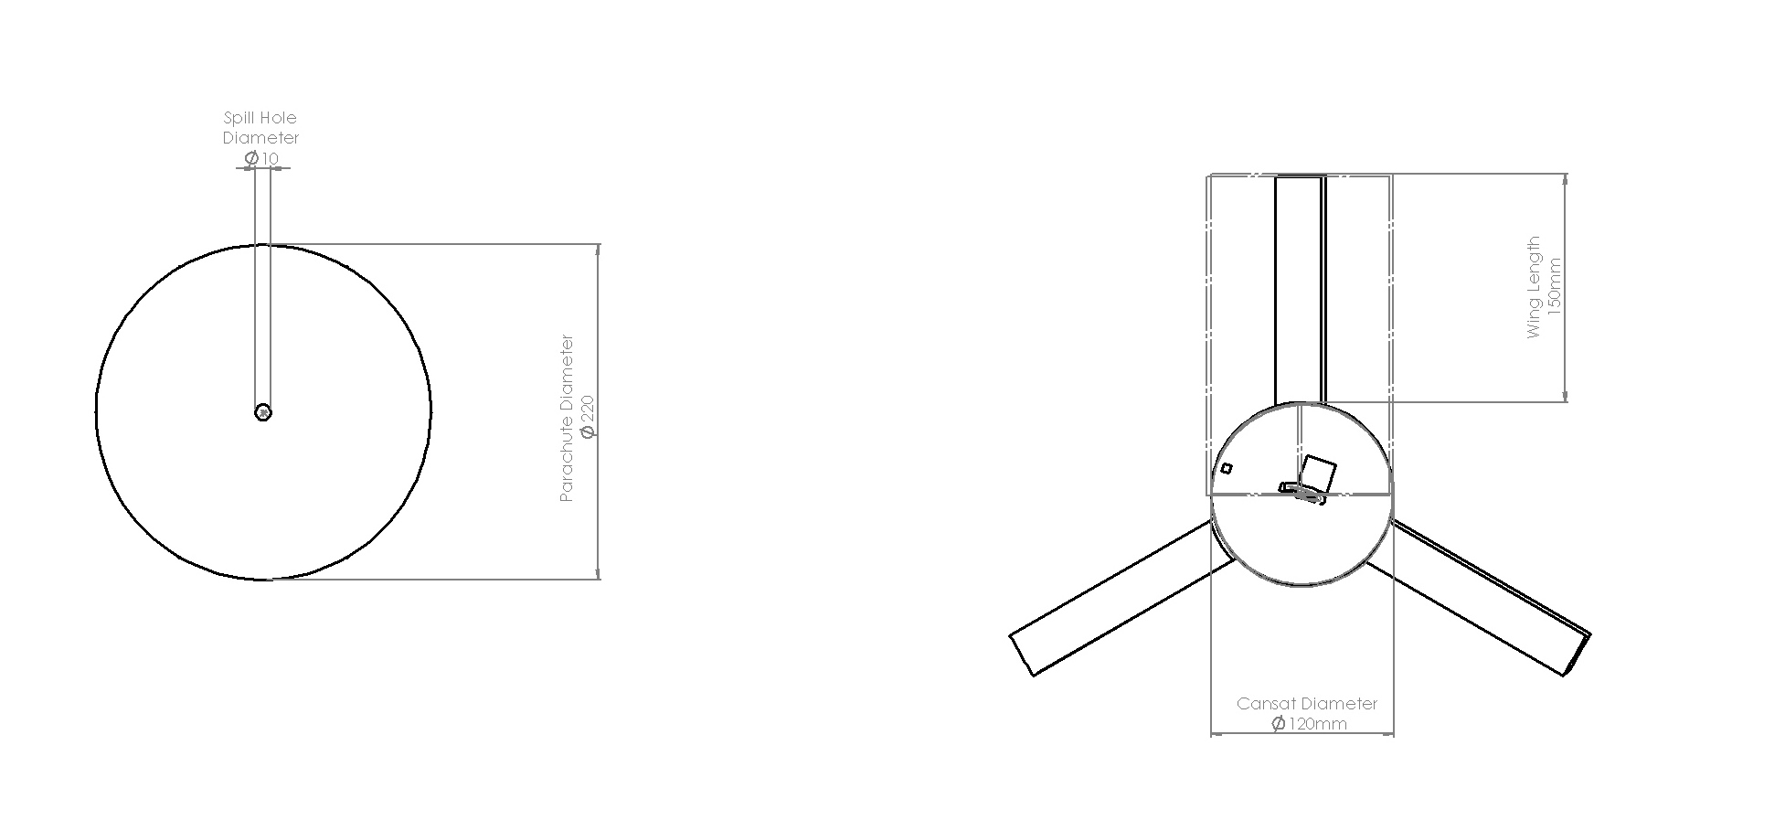
Physical Layout
Design – Top View
Wings Overlapping
Presenter: Rakesh N R

Slide 24
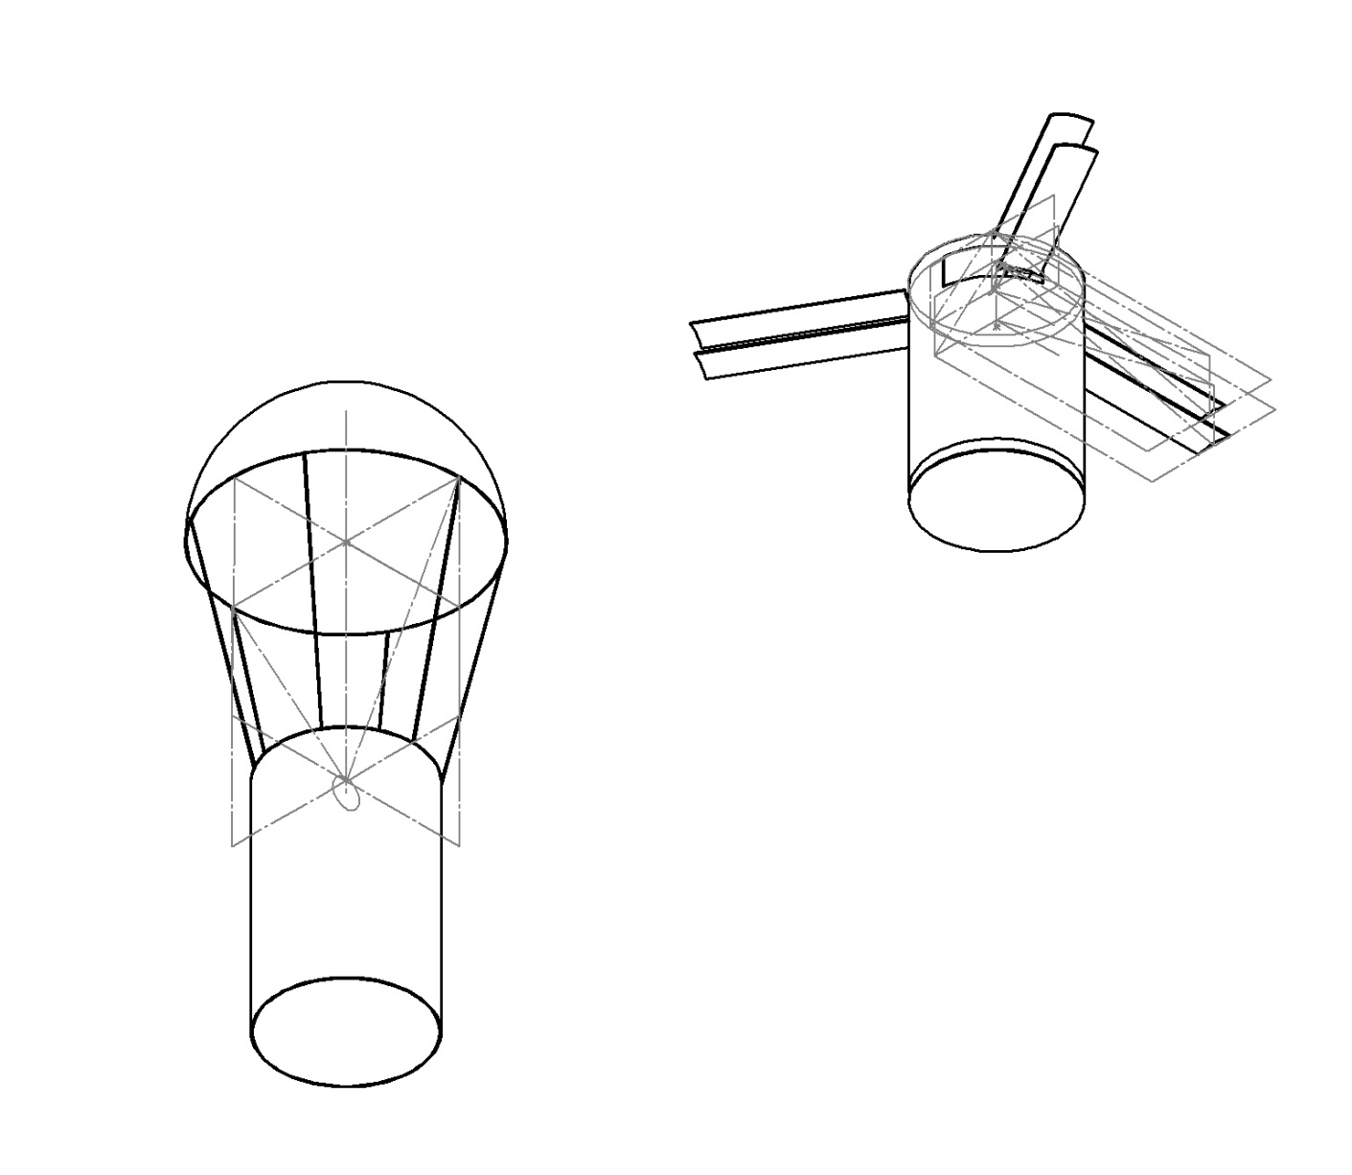
Physical Layout
Design – Isometric View
Presenter: Rakesh N R

Slide 25
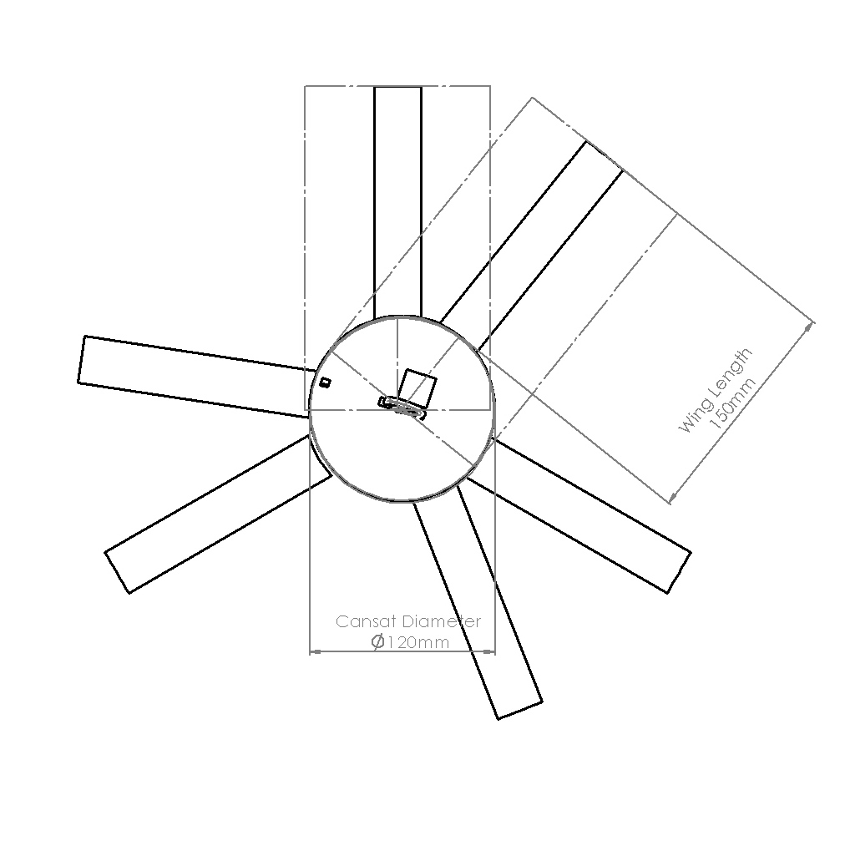

Physical Layout
Wings Staggered
Presenter: Rakesh N R

Slide 26
System Level Cansat Configuration Trade & Selection
Choice of aluminum over steel: Aluminum was chosen over steel keeping in mind the mass constraints.
The container containing the egg is kept at the bottom of the lander and the electronics is in the middle as we want the center of mass to be as low as possible to improve the stability of the cansat.
Wings were earlier thought to be made of aluminum, but later to have higher strength, lower mass and accurate geometry, we are thinking of using plastic/fiber material.
Presenter: Rakesh N R

Slide 27
Sensor Subsystem Design
Presenter : Rahul Gupta
Presenter: Rahul Gupta

Slide 28
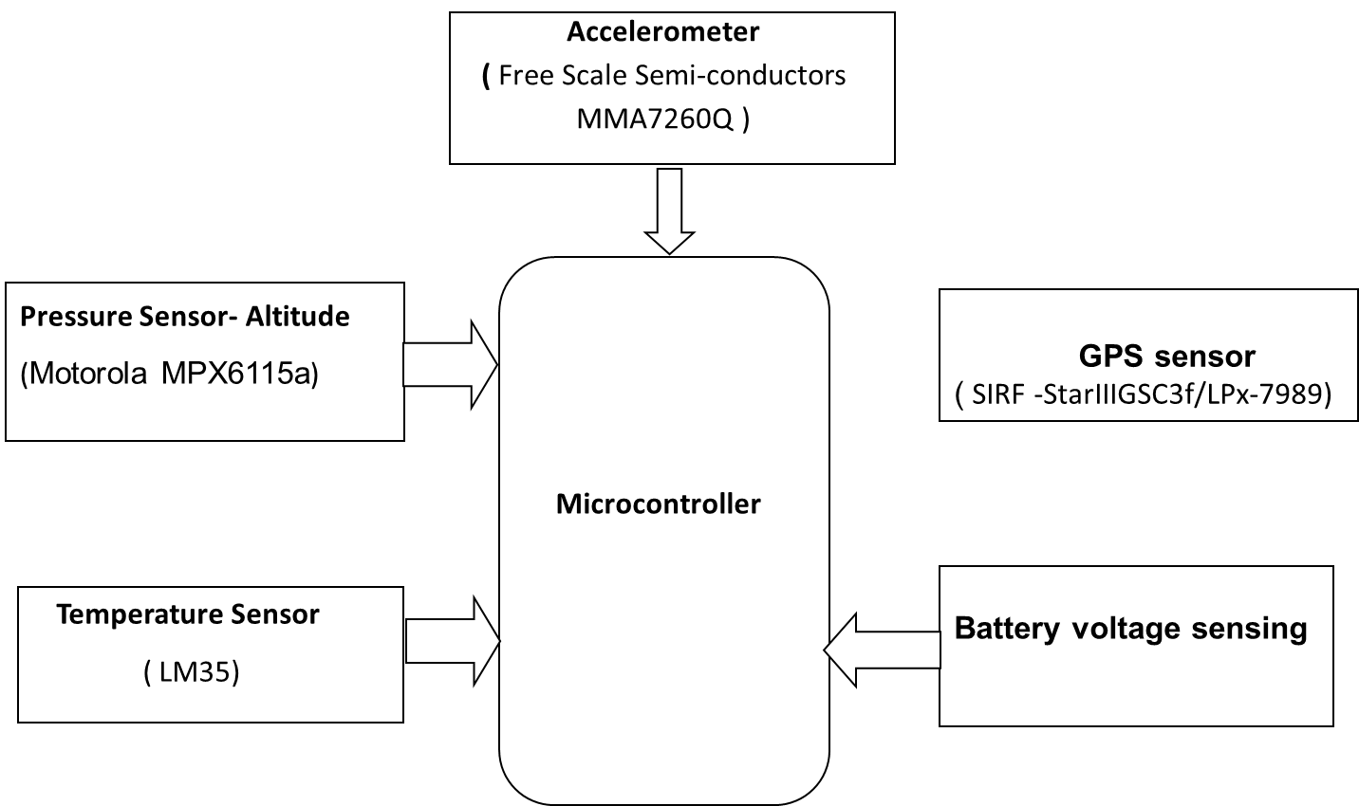
Sensor Subsystem Overview
Presenter: Rahul Gupta
28

Slide 29
Sensor Subsystem Requirements
ID | Requirement | Rationale | Parent | Children | Priority | VM
 |  |  |  |  |  | A | I | T | D
S01 | Measurement of barometric altitude | It is a requirement for descent telemetry | SYS -08,09 |  | HIGH | X |  | x | x
S02 | Measurement of air temperature. | It is a requirement for descent telemetry | SYS -08,09 | - | HIGH |  |  | X | x
S03 | Measurement of Battery Voltage. | Requirement for Descent Telemetry and Housekeeping Data | SYS-08,09 | - | HIGH |  |  | X
S04 | GPS Location data | Descent Telemetry and determination of Landing | SYS-08,09 | - | HIGH | X |  | X | x
S05 | Acceleration Sensor | Various events such as ejecting, mapping of motion and operational objective of landing data. | SYS – 08,09 | - | MEDIUM | X |  | x | X
S06 | Audio Beacon | It is required to retrieve the Cansat after it has landed. |  | - | MEDIUM
Presenter: Rahul Gupta
29

Slide 30
GPS Trade & Selection
Manufacturer | Model | Dimensions | Accuracy | Mass | Power/voltage
SIRF | StarIII GSC3f/LPx-7989 | Length:27mm, Width: 23mm | 5m | 10g | 75mw/3.3v
Garmin | OEM GPS 15H-W | Length:30mm, Width: 30mm | 4m | 15g | 85mw/8-40v
Global Sat | EM-406 | Length:30mm, Width: 30mm | 3m | 23g | 70mw/4.5v
GSC3f/LPx-7989 sensor is selected because it has much more accuracy than other sensors, also it weighs less and uses less power which are other critical parameters for the selection of GPS sensor.
SiRF GSC3f GPS Sensor
Presenter: Rahul Gupta
30

Slide 31
Non-GPS Altitude Sensor Trade & Selection
Manufacturer | Model | Accuracy | Mass | Current/voltage | Dimensions | A/D
Freescale | MPX6115a | +-1.5% | 25g | 0.5ma/5v | 16.6 * 7.2mm | A
Freescale | MPXH6101A | +-1.72% | 31g | 97ma/10v | 28.6 * 81.7mm | A
Vaisala | PTB210 | +-0.25hpa | 110g | 55ma/6v | 120mm * 30mm | D
MPX6115a Non-GPS Altitude Sensor is selected because it weighs less, consumes less power and is smaller than other two sensors in race.
MPX6115a Non-GPS Altitude Sensor
Presenter: Rahul Gupta
31

Slide 32
Non-GPS Altitude Sensor Trade & Selection
MPX6115a will act as lander pressure sensor.
Barometric pressure changes with respect to altitude and temperature
The relation between analog pressure and voltage in analog sensors is almost linear and is most of the times provided by the manufacturer
Pressure from Voltage :
P = 22.222 * V + 10.556 – (22.222*EF)
Height from Pressure :
MPX6115a Pressure Sensor
Presenter: Rahul Gupta
32

Slide 33
Air Temperature Trade & Selection
Product | Type | Operates in region | Accuracy
FM 75 | Digital | 0 – 100 degrees | +-1degree Celsius
LM 35 | Analog | 0 – 100 degrees | +- 0.5 degree Celsius
This temperature sensor is selected to fulfill the need of our mission because of it’s more accuracy than FM75, low cost and easy availability.
Other fact about using this sensor is that it is very simple to use it rather than using a digital temperature sensor which on other hand is expensive and not easily available.
LM 35
Presenter: Rahul Gupta
33

Slide 34
Lander Impact Force Sensor Trade & Selection
Model | Dimensions | Voltage/current Normal mode | Current Power saving mode | Range | Accuracy | Sensitivity Due to temp | A/D
Analog devices ADXL345 | 15mm*25mm | 3.3V/145uA | 0.1uA | ±16g | ±1% | ±0.01%/°C | D
Free Scale Semi-conductors MMA7260Q | 25mm*25mm | 3.3V/500uA | 3uA | ± 6g | ±5% | ±0.03%/°C | A
The ADXL345 is digital, low weight, higher accuracy, better range and low power consumption.
Presenter: Rahul Gupta
34

Slide 35
Lander Impact Force Sensor Trade & Selection
Model | Dimensions | Voltage/current Normal mode | Current Power saving mode | Range | Weight | Sensitivity Due to temp | A/D
Kistler 9712B250 | 16mm* 16mm* 13mm | 24V/4mA | 1uA | +1kN | 19g | - 0.009%/°F | A
Since we are worried that the cansat may rotate (due to winged structure), the accelerometer may not provide accurate results. Hence we are going for a physical sensor.
But due to requirement of extra space and very high voltage, decision has not yet been made.
Decision will be taken once Accelerometer is purchased and tests are performed.
Presenter: Rahul Gupta
35

Slide 36
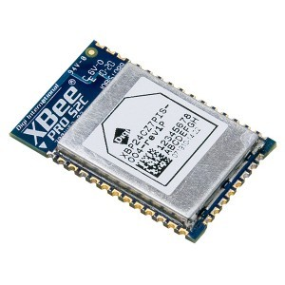
XBEE
Model | Dimensions | Voltage/current Normal mode | Indoor/Urbun Range | Outdoor/RF-Line of Sight Range | Transmit Power | A/D
XBEE PRO® 802.15.4(Series1) | 33mm*24 mm | 3.3V/100mA | 90 m | 3200 m | 63mW | D
XBee-PRO® ZB SMT | 21.99mm x 34mm | 3.3V/100mA | 100m | 3200m | 60mW | D
Presenter: Rahul Gupta
s
36

Slide 37
Descent Control Design
Presenter : Siddharth Singh

Slide 38
Descent Control Overview
The Descent control system will be achieved through the use of parachutes of appropriate size 22cm for Container and wings for Cansat and design keeping in mind the aerodynamics of the fall.
Proper design and right choice of materials will be the backbone of the Descent Control System. Extreme care and precision needs to be involved in design taking care of all possibilities.
Both Container and Cansat sections will have separate mechanisms to achieve the required constant descent speeds of 20(+/- 1)m/s.
While the Cansat is in the payload section , the parachutes will be closed such as to occupy an allotted space.
After deployment from the rocket airflow will cause the parachute of the carrier to inflate and the rate of descent will be controlled by the parachute.
At the time of separation(at 400m), spring system will cause the wings of the Cansat to open.
The spill hole at the top (1cm radius) will ensure continuous air flow through the parachute, thereby stabilizing it and ensuring descent at required speeds.
Presenter: Siddharth Singh
38

Slide 39
Descent Control Requirements
ID | Requirement | Rationale | Parent | Children | Priority | VM
 |  |  |  |  |  | A | I | T | D
DCS01 | Container chutes occupy their allotted space, whatever be the orientation of the payload. | to ensure a tangle free separation, and proper fitting while in payload. | SYS – 04 |  | HIGH
DCS02 | container chute size such that descent rate ~20m/s | Competition requirement | SYS- 01,04 |  | HIGH
DCS03 | Cansat descent rate ~20m/s | Competition requirement | SYS- 04 |  | HIGH |  |  | X
DCS04 | Materials used to be light and flexible. | To minimize mass and volume requirements. | SYS- 02 |  | MEDIUM
DCS05 | The descent control system shall not use any flammable or pyrotechnic device. | Safety. |  |  | MEDIUM
Presenter: Siddharth Singh
39

Slide 40
Container Descent Control Strategy Trade and Selection
Strategy selection
Strategy | Pros | Cons
Use of Wings | Orientation can be easily controlled using servo motors. | Controlling drift will not be possible using the mechanism
Use of parachute | Easy to design and attain required speed, low space requirement. | Drift(can be countered by a spill hole, affects area)
Material selection for parachute design
Silk- thin, light and easy to fold but expensive and not as elastic as nylon
Rip stop Nylon cloth - Due to property to block air , easy availability and good elasticity.
Strings to control shape : Nylon strings – High strength , easy to use and light.
Presenter: Siddharth Singh
40

Slide 41
Material selection for Wing design
The Possible materials for the design of the wing are
Aluminum
Plastic/Fiber
The material selection is based on the fact that the materials should be light weight and have high enough tensile strength to support the weight of the Cansat .
We have chosen to use plastic wings keeping in mind the weight constraints of the Cansat as well as the torque requirements for wing rotation.
Presenter: Siddharth Singh

Slide 42
Descent Rate Estimates
The size of the parachutes is fixed by calculation from the following relation.
r = sqrt( (2 m g) / (π p C_{d} v²) )
where,
π = 3.14159265359
ρ = 1.146 kg/m³ (density of air at 35 °C ) C_{d} = 1.5 (drag coefficient of the chute for a hemisphere chute)
v = Terminal velocity achieved (from mission required)
r = radius of the chute
g = acceleration due to gravity
Presenter: Siddharth Singh
42

Slide 43
Descent Rate Estimates
The area of the wing is calculated from the following relation.
A= (2 m g) / (p C_{d} v²)
where,
π = 3.14159265359
ρ = 1.146 kg/m³ (density of air at 35 °C ) C_{d} = 2.32 (AS MEASURED FROM EXPERIMENT)
v =terminal velocity achieved (from mission required)
A = area of the plate
g = acceleration due to gravity
Presenter: Siddharth Singh

Slide 44
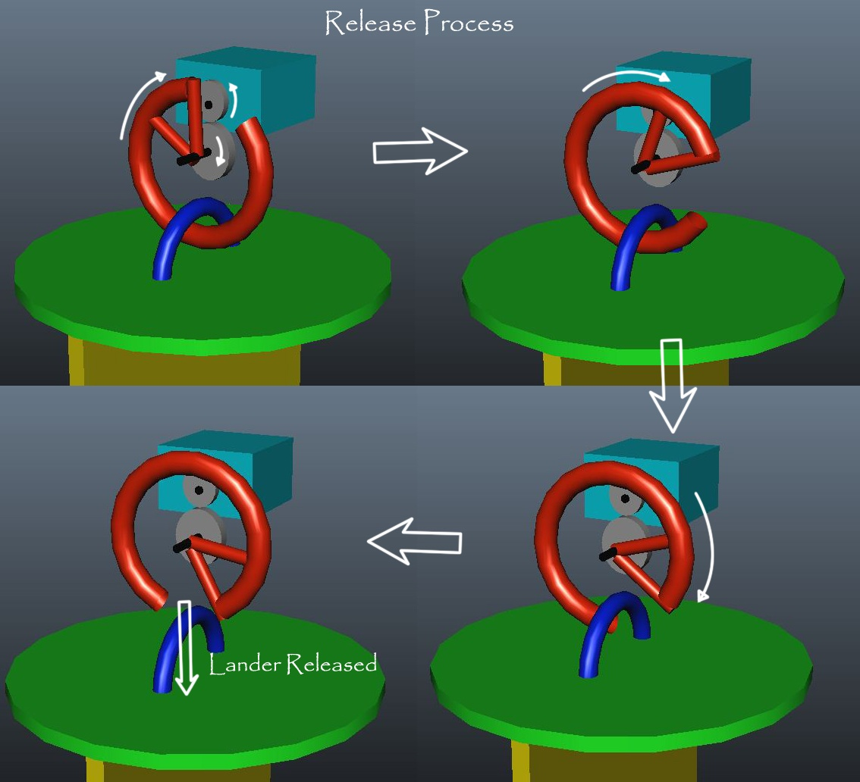
Cansat detachment strategy
Presenter: Siddharth Singh
44

Slide 45
Mechanical Subsystem Design
Presenter: Jaswanth Reddy

Slide 46
Mechanical Subsystem Overview
Presenter: Jaswanth Reddy
The major components of the cansat are the egg carrier , the carrier circuit , the wing system and the sensor arrangement.
Top layer is the wing system. The position of the wings are controlled by a servo attached underneath the cansat top cap.
After that there is space for PCB, sensor and batteries.
Then comes the egg container. It has a small slit for connecting the impact force sensor.
Impact force sensor is attached to the bottom of the cansat and provided with a metal sheet for larger area of impact measurement.
The entire body skeleton is made of aluminium.
Container and Cansat are interfaced using a motor-hook system. The servo controlling this lies to the top of cansat top cap.

Slide 47
Mechanical System Requirements
ID | Requirement | Rationale | Parent | Priority | VM
 |  |  |  |  | A | I | T | D
MS01 | Total mass of the Cansat will be 700+/-10gms excluding egg | Control system relies heavily on accurate mass estimation . | SYS -01 | HIGH |  | x | x
MS02 | Cansat will fit in a cylindrical envelope of 120mm diameter and 210 mm in length | Payload structure dimensions are influenced by launch vehicle characteristics | SYS -02 | HIGH |  | x
MS03 | There will be no protrusions until Cansat deployment from rocket payload | Payload structure dimensions are influenced by launch vehicle characteristics | SYS -02 | HIGH |  | x
MS04 | Cansat and egg placed inside should be recovered safely. | Structure should be able to withstand vibration shocks and protect the egg from breaking. |  | HIGH |  |  | x | x
MS05 | Placement of GPS Antenna , Transceiver Antenna | Placement of Sensors and Antennas have to be appropriate for proper Transmission and Reception | SYS-08,09 | MEDIUM |  |  | x | x
MS06 | Ensure smooth detachment of the container and the cansat at a height of 400m. | The wing system shouldn’t be harmed. |  | HIGH |  | x | x
Presenter: Jaswanth Reddy

Slide 48
Egg Protection Trade and Selection
Egg is best protected in the following conditions -
An Aluminum container is used for carrying the egg. The rationale of using aluminum is as follows:
The container is stuffed with polystyrene balls with egg in the middle.
Sponge and paper cushions were also considered but rejected based on test observations (Refer : Egg drop test In Integrated test section).
Polystyrene balls provide the required cushioning to protect the egg. Polystyrene balls are inexpensive, light weight and easily available
Material | Density (gms/cc) | Tensile strength (GPa) | Cost per square meter | Availability
Aluminum | 2.7 | 90 | 59.74 $ | Easily available
Carbon Fiber | 1.75 | 3.5 | 651 $ | Facility not yet identified
Steel | 7.9 | 1.3 | 52.31 $ | Difficult
Presenter: Jaswanth Reddy

Slide 49
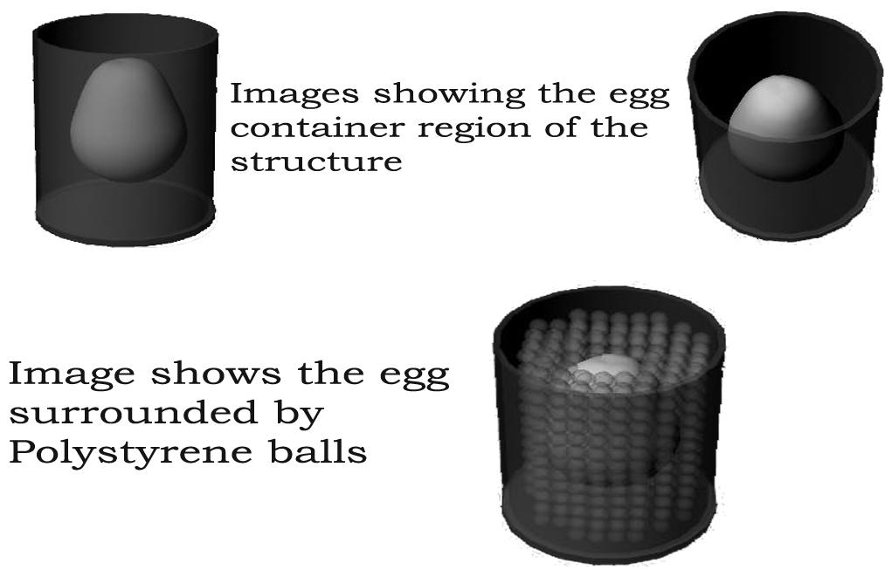
Egg Protection Trade and selection
Presenter: Jaswanth Reddy

Slide 50
Mechanical Layout of Components Trade & Selection
The Battery and the rest of the electronics have been placed on opposite sides to ensure that center of mass remains near the center of the structure for proper balance.
The motor-hook arrangement is placed at the center of the CanSat cross-section for smooth release.
Presenter: Jaswanth Reddy

Slide 51
Estimated Mass Budget
Item | Weight (g)
Mass of Skeleton (Container) | 225
Mass of Skeleton (Cansat) | 190
Mass of Wings | 30
Mass of PCB (including microcontroller, temp. Sensor) | 30
Servo Motor*2 + Antenna + Buzzer + Others | 85
Battery*2 | 105
Parachute | 20
Egg Cushioning | 20
TOTAL | 705
Presenter: Jaswanth Reddy

Slide 52
Communication and Data Handling Subsystem Design
Presenter : Gauresh Patil

Slide 53
CDH Overview-1
Cansat
Processor: AtMega 128 ( As Central Processing Unit of the Carrier; sensing, processing, transmitting, storing telemetry data)
Memory: Atmel0736 (For storing telemetry data onboard for backup in case of communication failure)
Radio Transceiver: XBee-PRO® ZB SMT Transceiver (For transmitting data to ground station once every 2 seconds)
Antenna : A24-HASM-450 (2.1dBI)
Presenter: Gauresh Patil

Slide 54
CDH Overview-2
Ground Station
Radio Transceiver: XBee-PRO® ZB SMT Transceiver (For receiving data from the carrier once every 2 seconds)
Xbee USB Explorer
Antenna : A24-HASM-450 (2.1dBI)
Intel Core i3 Processor Laptop.
Presenter: Gauresh Patil

Slide 55
CDH Requirements-1 (Container)
ID | Requirement | Rationale | Parent | Priority | VM
 |  |  |  |  | A | I | T | D
CDH01 | Transmit GPS Data Stream | Descent Telemetry packet (transmitted every 2 seconds) | SYS -08 CD-01 | HIGH |  |  | x | x
CDH02 | Transmit Altitude in meters | Descent Telemetry packet (transmitted every 2 seconds) | SYS-08 CD-01 | HIGH |  |  | x | x
CDH03 | Transmit Air Temperature in Celsius | Descent Telemetry packet (transmitted every 2 seconds) | SYS-08 CD-01 | HIGH |  |  | x | X
CDH04 | Transmit Battery Voltage in Volts | Descent Telemetry packet (transmitted every 2 seconds) | SYS-08 CD-01 | HIGH | x |  | x | x
CDH05 | Terminate Telemetry | Terminate Telemetry within 5 minutes of landing. | SYS-08,09 CD-01 | HIGH | x |  | x | x
CDH06 | Store Telemetry Data | For Post Processing in case of Communication Failure | SYS-11 | LOW
Presenter: Gauresh Patil

Slide 56
CDH Requirements-2 (Cansat)
ID | Requirement | Rationale | Parent | Priority | VM
 |  |  |  |  | A | I | T | D
CDH06 | Store/Transmit Cansat Altitude Measured | Descent Telemetry packet (stored every 2 seconds) | SYS-11 | HIGH |  |  | x | x
CDH07 | Store/Transmit Cansat Battery Voltage | Descent Telemetry packet (stored every 2 seconds) | SYS-11 | HIGH |  |  | x | x
CDH08 | Storing the Impact Force | Impact Force (Stored when cansat hits the ground) | BONUS | HIGH
CDH09 | Send stored descent telemetry to Ground Control | For post-processing following retrieval of Lander | SYS-11 | HIGH |  |  | x | X
Presenter: Gauresh Patil

Slide 57
CDH Requirements-3 (GROUND STATION)
ID | Requirement | Rationale | Parent | Priority | VM
 |  |  |  |  | A | I | T | D
CDH09 | Receive GPS Data Stream | Descent Telemetry packet Receive every 2S | CD01 | HIGH |  |  | x | x
CDH10 | Receive Altitude in meters | Descent Telemetry packet (received every 2 seconds) | CD01 | HIGH |  |  | x | x
CDH11 | Receive Air Temperature in Celsius | Descent Telemetry packet (received every 2 seconds) | CD01 | HIGH |  |  | x | X
CDH12 | Receive Battery Voltage in Volts | Descent Telemetry packet (received every 2 seconds) | CD01 | HIGH | x |  | x | x
CDH13 | Plot telemetry data In real time | Ret real time feel for what is happening. | CD01 | HIGH | x |  | x | x
Presenter: Gauresh Patil

Slide 58
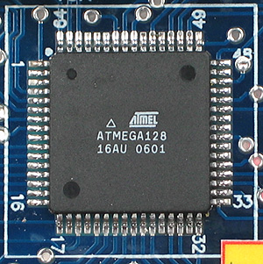
Processor : Trade & Selection
Cansat: AtMega128
Maximum Clock Frequency 16 MHz (external)
Data Interfaces:
USART: 2 (One for Transceiver and
one for GPS)
SPI: 1(For memory)
ADC PORTS: 8 channels(one each
for battery voltage, temperature sensor and pressure
Sensor, impact force sensor)
On chip Flash Memory: 128 Kb
SRAM / EEPROM: 4 Kb
Supply Voltage: 4.5V – 5V
Presenter: Gauresh Patil

Slide 59
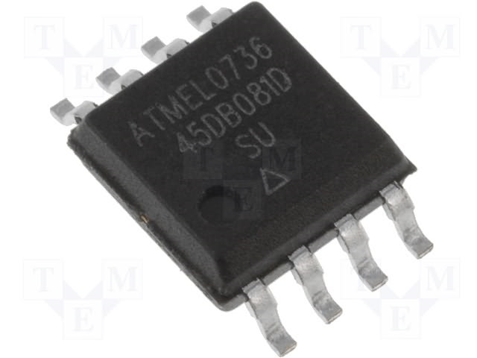
Memory : Trade & Selection
If 1 minutes of Descent Telemetry(carrier) sampled at 2 seconds
60 * ( 50 bytes ) ~= 3 kB
If Acceleration Data is calculated with 100 samples per second :
3*100*10 bits ~= 0.4 kB
Totally it adds up to around 4 kB.
Atmel Memory chip
8 MB, SPI Mode, Chip Select Available
Its cheap and readily available.
Presenter: Gauresh Patil

Slide 60
Carrier Antenna Trade & Selection
The Antenna had to be matching for the range of
2.4 GHz.
Have preferably an MMCX connector against SMA,BNC or TNC .
High Decibel Gain
VWSR less than 2.0 : 1
Half Wave Dipole and Omni Directional
Antenna Chosen: A24-HASM-450 (2.1dBI)
Presenter: Gauresh Patil

Slide 61
Communications Configuration
Fixed baud rate of 57600 bps , channel 0 in Receive mode for query wait
Transceiver programmed for API control Mode
The system in API mode set at fixed baud rate and channel transmits and receives through a 3 byte MAC address which can either be hard coded on the EEPROM or sent dynamically.
Transmit when asked for a query, through UDR buffer
Presenter: Gauresh Patil

Slide 62
Carrier Telemetry Format
Data sent every 2 seconds with baud rate of 57600 bps.
Data Format: Data Format will be finalized in CDR
Characters | Definition
cc. | State
hhmmss | Data time tag in hours , minutes and seconds
Hhmmss | Mission Time
N | Start of latitude data
AA.aaaa | Cansat latitude
W | Start of longitude data
BB.bbbb | Cansat Longitude
hh.hh.. | Cansat GPS altitude
Ab | Number of satellites tracked in decimal
vv. | Pressure Sensor Sampled Data
tt. | Air temperature ( 1 degree resolution)
vv. | Battery voltage
States
BOOT
TEST_MODE
LAUNCH_PAD
ASCENT
PARA
CANSAT
IMPACT
BUZZER
Presenter: Gauresh Patil

Slide 63
Autonomous Termination of Transmissions
To terminate telemetry:
This will be done via a check in the loop which compares the altitude from GPS data to altitude from several previous data packets, accelerometer output and impact force sensor. If the altitude remains same for a certain amount of time and accelerometer gives a very high value and impact force sensor records impact, we conclude that the cansat has landed and that its time to stop sending the telemetry.
The GCS will recognize the end of telemetry by the special custom occurrence of special character.
Presenter: Gauresh Patil

Slide 64
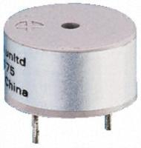
Locator Device Selection
We are going to use a buzzer to locate the cansat after impact.
The buzzer selected is pro-Signal ABI-001-RC.
It is Rated at greater than 80dB at 10cm distance.
Power consumed is 84mW.
Presenter: Gauresh Patil

Slide 65
Electrical Power Subsystem Design
Presenter : Shashank Wadhwa

Slide 66
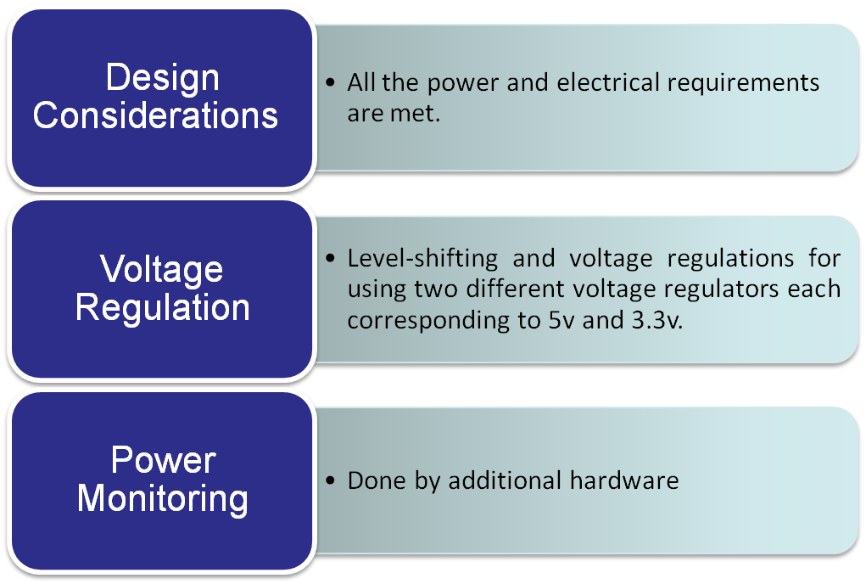
EPS Overview
Presenter: Shashank Wadhwa
66

Slide 67
EPS Requirements For Cansat System
ID | Requirement | Rationale | Parent | Priority | VM
 |  |  |  |  | A | I | T | D
EP01 | Voltage Requirement (5V, 3.3V) | 5V required for MicroController, Temperature Sensor and Servo. 3.3V for Memory, Pressure sensor, Accelerometer, Transceiver and GPS. | EP02 | MEDIUM |  |  | x | x
EP02 | Battery Requirement (9V) | To be able to provide adequate power for the whole period of flight. | ----- | MEDIUM |  | x
Presenter: Shashank Wadhwa
67

Slide 68
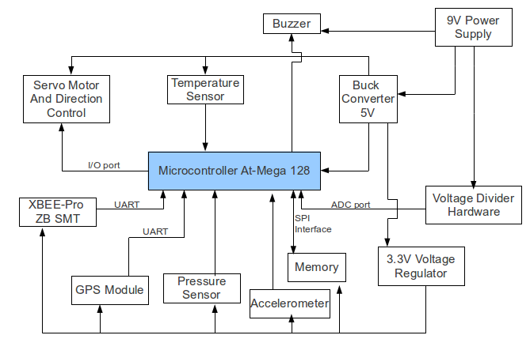
Cansat Electrical Block Diagram
External Power Switch will be present to control the power flow in the system.
Battery Voltage will be read using microcontroller-ADC.
Presenter: Shashank Wadhwa
68

Slide 69
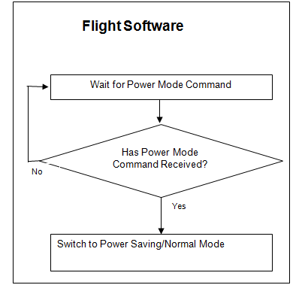
Power Control without
disassembling the Cansat
Idle Mode: In this mode, the processor would disable the CPU
Also there will be an external switch to enable battery.
Presenter: Shashank Wadhwa
69

Slide 70
Power Budget
Device | Average Power consumption (mWatts) | Voltage | Average Current | Usage
GPS | 75 mW | 3.3V | 23 mA | 3 hrs
Pressure Sensor | 1.65 mW | 3.3V | 0.5mA | 3 hrs
Temperature Sensor | 75 mW | 3.3V | 23mA | 3 hrs
XBEE-Pro ZB SMT | 376 mW | 3.3V | 100mA | 3 hrs
Microcontroller | 110 mW | 5V | 28mA | 3 hrs
Flash memory | 16.5 mW | 3.3V | 5mA | 3 hrs
Buck Convertor 5v |  |  | 92% eff
Buck converter 3.3v |  |  | 90% eff
Voltage divider H |  |  | Negligible
Servo Motor | 2*1W | 5v |  | (Descent time)
Buzzer | 63 mW | 9 V | 7mA | 1 hr
Presenter: Shashank Wadhwa
70

Slide 71
Total Power Budget
Total Power used by main components is 718.15 mWh.
Voltage conversion of 90% efficiency in 3.3v and 92% in 5v for Buck Convertors.
Life of each Battery: 2.15 hours (approx )
Presenter: Shashank Wadhwa

Slide 72
Power Source Trade & Selection
Name | Voltage/Power | Type | Mass
6F22 Heavy duty | 9v / 500mah | Alkaline | 45g
UBP 001 | 3.7v/1800mah | Lithium Ion | 41g
Dura Cell | 9.6v/ 170mah | Ni Mh | 47g
We are using Dura Cell as it is most easily available
and highly efficient for the purposes required.
Presenter: Shashank Wadhwa
72

Slide 73
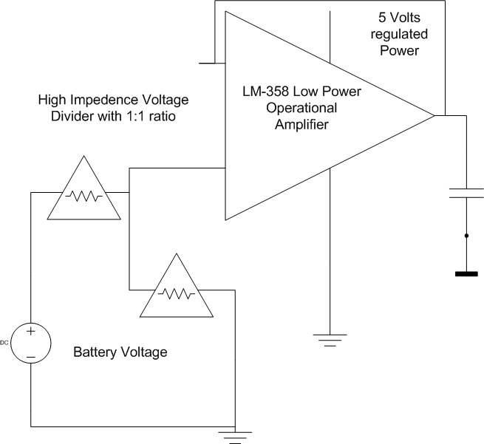
Battery Voltage Measurement Trade & Selection
Battery Voltage is measured by giving a high impedance voltage divider with outsourcing and then interfaced to the ADC port.
Presenter: Shashank Wadhwa
73

Slide 74
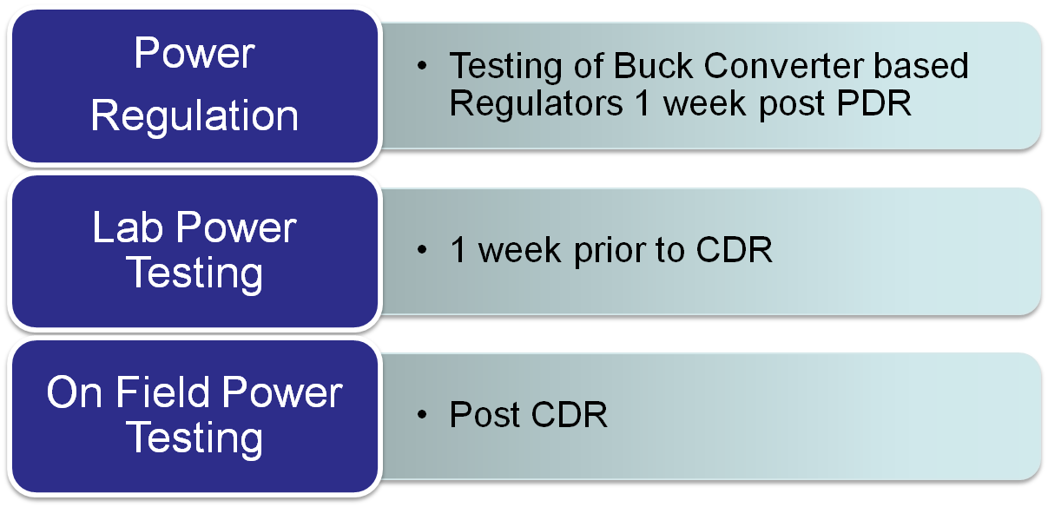
EPS Testing Overviews
Presenter: Shashank Wadhwa
74

Slide 75
Flight Software Design
Presenter : Rakesh N R

Slide 76
FSW Overview
The FSW will work in a Microcontroller(Atmega128). Its basic structure will be as follows:
Sensors
Gather Data
FSW
Transmit Via
Antenna
Store in
Electro-Mechanical Release Mechanism
Wing Position Control
Memory
Presenter: Rakesh N R
76

Slide 77
FSW Overview
The FSW will collect data from all the sensors and store it onto the onboard memory. It will also transmit the collected data via XBEE.
It will also initialize the Electromechanical Mechanism used to release the Cansat from the container at the height of 400 meters.
The FSW for the Cansat will collect data from the altitude sensor and the impact sensor and store it onto the onboard memory so as to be analyzed later.
Complete FSW will be developed in C with an AVR GCC environment. All C programs are compiled and dumped as HEX codes in ATMEL microcontrollers which forms the embedded platform of our Cansat. We have chosen this platform because we are familiar with it as it is a part of our curriculum.
Presenter: Rakesh N R
77

Slide 78
FSW (Cansat) Requirements
ID | Requirement | Rationale | Parent | Priority | VM
 |  |  |  |  | A | I | T | D
FSC01 | Collection of Sensor data in processor and formation of packet | Reception of data values from sensors and analysis in firmware to produce data packets | CD01 | HIGH | x |  | x | x
FSC02 | Data packet to be sent to RF Transceiver via USART. | Packet sent for Transmission to Relay | CD01 | HIGH |  |  | x | x
FSC03 | Packets sent also stored as Data backup. | Packet also sent to memory for Data-packet backup. | CD01 CD04 CD06 | LOW |  |  |  | x
FSC04 | Control the Release mechanism of the lander | So that the lander can be released at height of 400 meters | CD03 | LOW | x |  | x | x
Presenter: Rakesh N R
78

Slide 79
Software (Cansat) flow diagram(High Level)
Boot
Send State Vector to Ground Station
Command from ground station to start transmission
Retrieve State Vector
Yes
If Launch pad
No
Measure
Speed
Impact Condition
No
Equal to
20
Less than
20
More than
20
Yes
Power Down all the systems and start the buzzer
Do
nothing
Rotate Wing inwards
Rotate wing outwards
Presenter: Rakesh N R
79

Slide 80
Sensors
Pressure Sensor:
Interfaced via ADC
sampled at 10kHz
Battery Voltage Sensor:
Interfaced via ADC
sampled at 10kHz.
Accelerometer X,Y and Z:
Interfaced via ADC( 3 ADC ports)
sampled at 100Hz.
Memory : Memory chip is interfaced via SPI
Presenter: Rakesh N R
80

Slide 81
Ground Control System Design
Presenter : Rakesh N R
81

Slide 82

GCS Overview
Antenna receives from the Cansat passes it forward for processing
Xbee Explorer Dongle connected to USB of the Laptop
GCS uses the data received to populate various tables and plot graphs. The software clearly indicates the phases of flight, i.e. pre-launch, moving upwards, deployment, coming down, landed etc..
Presenter: Rakesh N R

Slide 83
GCS Requirements
ID | Requirement | Rationale | Priority | Parent | Children | VM
 |  |  |  |  |  | A | I | T | D
GCS01 | Antenna placement : Antenna must point upward, towards the Cansat | For better signal reception. | Medium | None | GCS02 GCS03 |  |  | X
GCS02 | Computational requirements : Data is received at 0.5 Hz. | Computational speed is not a big issue. (Assuming GCS laptop has a reasonably fast processor) | Low | GCS01 | None |  |  | X
GCS03 | Power Requirement : Should be able to receive and display data for about 3 hrs. | GCS has to be ready always for the communication. Not a big issue as ample power is available. | Medium | GCS01 | GCS05 |  |  | X
GCS04 | Analysis Software requirements : Should support Java, C/C++. | To be able to run analysis software. | High | None | None |  | X | X
GCS05 | Mission operations : Includes the detection of various phases by the GCS | To be able to distinguish between various states of flight. | Medium | GCS03 | None |  |  | X
Presenter: Rakesh N R
83

Slide 84
GCS Antenna Trade & Selection
Name | Range | Gain | Radiation Direction | Mass
Antenova B58124 | 1 Km | 1.8dB | Omni | 2g
A24-HASM-450 | 3.2 Km | 2.1dB | Omni | 25g
The first one is small easy to accommodate and light weight, but lacks in providing the required range hence communication fails, which is an extremely important objective of the Cansat mission. Thus we select the one which gives us the required range.
Presenter: Rakesh N R

Slide 85
Cansat Integration and Test
Presenter : Syed Tabish Abbas

Slide 86
Integration of Cansat subsystems
Integration of Container and Cansat
We used a servo motor to control a hook that holds the Container and the Cansat.
Integrations in Container
EPS, DC
There will be a servo motor for the hook release of Cansat.
Integrations in Cansat
EPS , SS , CDHS and SS
There will be two stacks of PCB’s one on top of each other .
There will be two batteries . One of the batteries is going to serve as a backup in case the other one fails .
Presenter: Syed Tabish Abbas

Slide 87
Tests Performed
Sensor Testing
The sensor will be tested after procurement .
The sensors selected so far are :-
GPS sensor(SIRF GSC3f/LPX7989)
Temperature Sensor (LM35)
Pressure Sensor (MPX6115A)
Accelerometer (MMA7260Q)
Presenter: Syed Tabish Abbas
87

Slide 88
Tests Performed
Mechanical Testing
Egg drop tests to decide the cushioning material .
Test conditions include free fall and windy conditions .
Trial | Outer case | Inner filling | Drop Height (feets) | Velocity at Ground Level (metres/second) V = √(2gh) | Results
1 | Aluminum container | Sponge + Paper Cushion | 40 | 15.5 | FAIL
2 | Aluminum container | Sponge + thermacol balls | 20 | 11 | PASS
3 | Aluminum container | Sponge + polystyrene balls | 40 | 15.5 | Pass
4 | Aluminum container | Sponge + polystyrene balls | 60 | 19 | Pass
Presenter: Syed Tabish Abbas
88

Slide 89
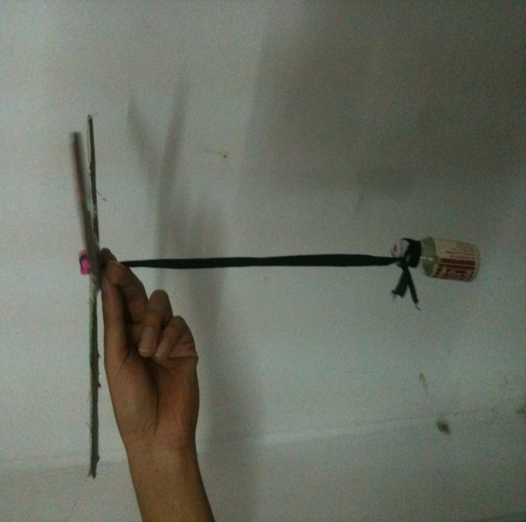
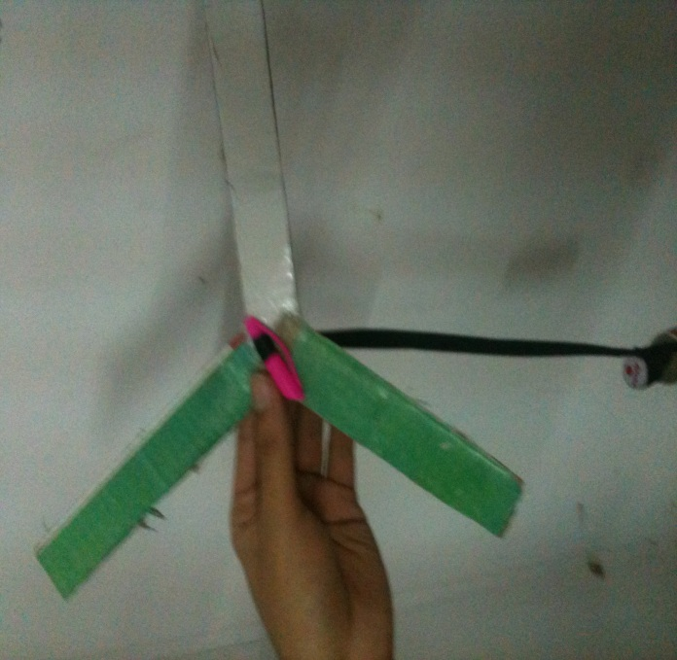
Tests Performed
Descent Control Testing
The test was performed using a prototype of the proposed Cansat control system using Simple wings made from cardboard .
The test shows that the prototype achieves Terminal Velocity after some distance .
Presenter: Syed Tabish Abbas
89

Slide 90
Tests to be Performed
Communication Testing
Flight Software Testing
Detachment Testing during Flight
Cansat Position Estimation Testing
Final Structure Testing
Electronics Testing
Presenter: Syed Tabish Abbas
90

Slide 91
Mission Operations & Analysis
Presenter: Siddharth Singh

Slide 92
Overview of Mission Sequence of Events
Preliminary launch-day sequence of events
–Arrive at the Launch site well in-time
–Locate a workspace for the team
–Layout the team’s equipment and put up the team’s banner
–Collect the launch time schedule
–Assemble the Cansat and carrier for final check
–Setup GCS
–Verify communication between Cansat and GCS
–Collect and place the Egg in its container
–Proceed to place the Cansat in the payload section of the rocket
–Post Launch – run all the GCS operations
–On successful landing of Cansat, proceed for recovery
–Pack up and leave the Launch site
Presenter: Siddharth Singh

Slide 93
Cansat Landing Coordinate
Prediction
DCS will keep track of GPS readings during descent.
The sensor data will be taken after each 2 seconds. This timing is done by the onboard controller.
After detachment the co-ordinates of Cansat will be predicted on the basis of GPS readings at the carrier.
After some Readings Trajectory of the Cansat can be estimated.
The DCS will be enabled as soon as Cansat will come out of Rocket.
It keeps track of height using Altitude Sensor.
At 400 Meter height Cansat and Container detach with DCS on Container tracking co-ordinates of Cansat.
Further Trajectory can be estimated by extrapolation.
Cansat in Container
Reading is taken
every 2sec
Cansat
Container
Presenter: Siddharth Singh
93

Slide 94
Cansat Location and Recover
Cansat Recovery
The co-ordinates of Cansat will be estimated by FSW that will help us to find the exact location of Cansat on the ground. This is a heuristic approach based upon GPS data as follows we store the position of Cansat before separation of container and Cansat in the memory at every 2 sec interval. This will depict the trajectory of the Cansat as it falls. This can be extrapolated taking into consideration local wind effect as altitude decreases to predict the trajectory and final position of Cansat.
The Cansat will have a shiny body after detachment from the container which will help in easy detection of the Cansat. There would also be a Buzzer that would keep on sounding for one hour thus helping in easy tracking of the Cansat .
Presenter: Siddharth Singh
94

Slide 95
Management
Presenter : Siddharth Singh

Slide 96
Cansat Budget – Hardware
Component | Quantity | Unit Price (in USD) | Cost (in USD)
Atmega128 microcontroller | 1 | 6.8 | 6.8
Temperature Sensor | 1 | 16 | 16
Accelerometer | 1 | 7 | 7
Battery | 2 | 22 | 44
Servo Motor | 2 | 5 | 10(mini)
Circuit Fabrication | 2 | 10 | 20
GPS Equipment | 1 | 108 | 108
Electronics system |  |  | 71.3
Xbee Explorer Dongle | 1 | 25 | 25
Structure material and Fabrication |  | 200 | 200
Rip-Stop Nylon | 3 | 18 | 54
Miscellaneous |  | 20 | 20
Margin | 15% | 41.3 | 66.1
Total |  |  | 646.5
Presenter: Siddharth Singh
96

Slide 97
Program Schedule
Electronics Team
Task | Scheduled Dates (dd/mm/yy) |  | Actual Dates (dd/mm/yy) |  | Reasons for not completing
1. Recognition of Tasks | 1/1/13 | 4/1/13 | 1/1/13 | 7/1/13
2. Allocation and Division of Tasks | 5/1/13 | 10/1/13 | 8/1/13 | 14/1/13
3. Identification of Systems and System Architecture | 11/1/13 | 15/1/13 | 14/1/13 | 17/1/13
4. Testing of Available components from previous year | 15/1/13 | 27/1/13 | 17/1/13 | 18/1/13
5. PDR Report and Presentation | 27/1/13 | 31/1/13 | 27/1/13 | 5/2/13 | Mid-sem exams and R&D showcase organized in our college
6. Hardware Procurement Begins | 10/2/13 | 17/2/13
7. Basic System Integration | 17/2/13 | 15/3/13
8. Work on Image Sensing and Orientation | 15/3/13 | 25/3/13
Presenter: Siddharth Singh
97

Slide 98
Program Schedule(contd.)
Electronics Team
Task | Scheduled Dates |  | Actual Dates |  | Reasons for not completing
9. CDR PPT and PDF | 25/3/13 | 29/3/13
10. Accelerometer Interfacing | 1/4/13 | 10/4/13
11. Flight Software Development | 11/4/13 | 25/4/13
12. Testing of Prototype | 25/4/13 | 5/5/13
13. Fabrication of Final PCB | 6/5/13 | 15/5/13
14. Field Testing of Hardware with System | 16/5/13 | 5/6/13
15. Flight Operations Preparation | 6/6/13 | 11/6/13
Presenter: Siddharth Singh
98

Slide 99
Mechanical Team Schedule
Mechanical and Descent Control Team
Task | Scheduled Dates |  | Actual Dates |  | Reasons
1. Recognition of Tasks | 1/1/13 | 15/1/13 | 1/1/13 | 15/1/13
2. Descent Mechanism Design | 16/1/13 | 20/1/13 | 16/1/13 | 24/1/13
3. Egg Landing Test on Materials | 20/1/13 | 25/1/13 | 23/1/13 | 25/1/13
4. Mechanical Structure Design | 25/1/13 | 27/1/13 | 25/1/13 | 27/1/13
5. PDR report and presentation | 27/1/13 | 31/1/13 | 27/1/13 | 3/1/13
Presenter: Siddharth Singh
99

Slide 100
Mechanical Team Schedule(contd.)
Mechanical and Descent Control Team
Task | Scheduled Dates |  | Actual Dates |  | Reasons
6. Descent Control Hardware | 1/2/13 | 15/2/13
7. Designing Descent Control | 16/2/13 | 25/2/13
8. Integrating Descent Control with Egg Canopy | 25/2/13 | 5/3/13
9. Testing of Structure for operation | 5/3/13 | 15/3/13
10. Make necessary changes in descent or Egg mechanism | 15/3/13 | 15/4/13
11. Testing with Changes | 15/4/13 | 1/5/13
12. Fabrication of Final Structure | 1/5/13 | 10/5/13
13. Testing with integrated Hardware | 10/5/13 | 25/5/13
Presenter: Siddharth Singh
100

Slide 101
Conclusions
Accomplishments :
Detachment mechanism finalized.
Physical structure layout finalized.
Sensors and components are decided.
Descent mechanism decided.
Preliminary Testing of Descent mechanism done.
Sensors tested.
Yet to be done :
PCB design is yet to be finalized.
Physical structure needs to be prepared.
FSW code has to be written.
GCS code has to be written.
We are ready for the next stage which is - Implementation of the subsystems
according to the conclusions we’ve reached upon.
Presenter: Siddharth Singh
101

Slide 102
THANK YOU
THANK YOU
THANK YOU

